Slide 1
Global Progress: Unraveling the Threads of Development
We aim to provide a comprehensive analysis of global development using The World Bank's World Development Indicators dataset. Through data visualization, we will explore the intricate connections between GDP, Population, Healthcare Expenditure, Internet Usage, Tourism, and Business, as follows :
Population Insights: Understand population trends and their implications.
Economic Trends: Uncover insights into global GDP dynamics.
Healthcare & Well-being: Analyze the impact of healthcare spending on life expectancy and infant mortality.
Digital Divide: Examine how internet usage influences disparities among nations.
Environmental Concerns: Explore CO2 emissions and their consequences.
Tourism Impact: Uncover the role of tourism in national economies.
Ease of Business: Investigate business environments and their impact on economies.
Key Questions: What drives global development, and how do these factors interconnect? How can developing and underdeveloped countries accelerate their growth?

Slide 2
Information about the Dataset
Our dataset has 27 variables in total which contain information about various countries or regions, with data collected for multiple variables over a specific year. The variables provide insights into different aspects of each country or region's economic, social, and environmental conditions.
It includes categorical variables like Country/Region, Region, and Year.
The numeric variables include Birth Rate, Business Tax Rate, CO2 Emissions, Days to Start Business, Ease of Business, Energy Usage, GDP, Health Exp % GDP, Health Exp/Capita, Hours to do Tax, Infant Mortality Rate, Internet Usage, Lending Interest, Life Expectancy Female, Life Expectancy Male, Mobile Phone Usage, Number of Records, Population 0-14, Population 15-64, Population 65+, Population Total, Population Urban, Tourism Inbound, Tourism Outbound.
We derived new variables like GDP Per Capita, Average Life Expectancy, CO2 emissions per capita , Ease of Business Cluster, Birth Rate bins and created new normalised variables like birth rate, infant mortality rate, life expectancy Health Expenditure/Capita, CO2 Emissions, Energy Usage for correlation purposes.
We would now sequentially display all our 5 Dashboards. Here are the online links :
1) https://public.tableau.com/app/profile/k.sethu.srivatsa/viz/FinalProject_16989415359760/Dashboard1 2)https://public.tableau.com/app/profile/k.sethu.srivatsa/viz/IDV_Proj_16992859684150/Dashboard4?publish=yes

Slide 3
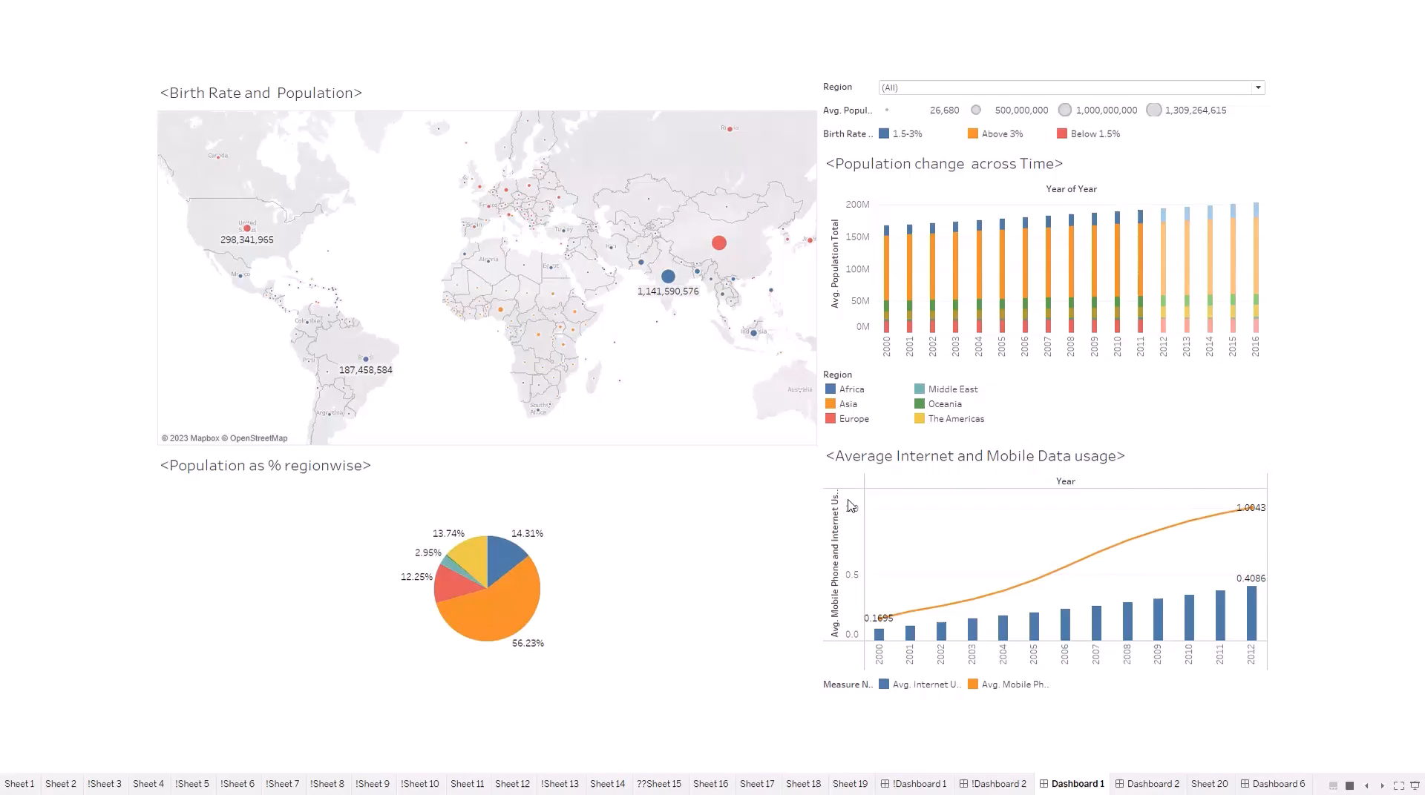

Slide 4
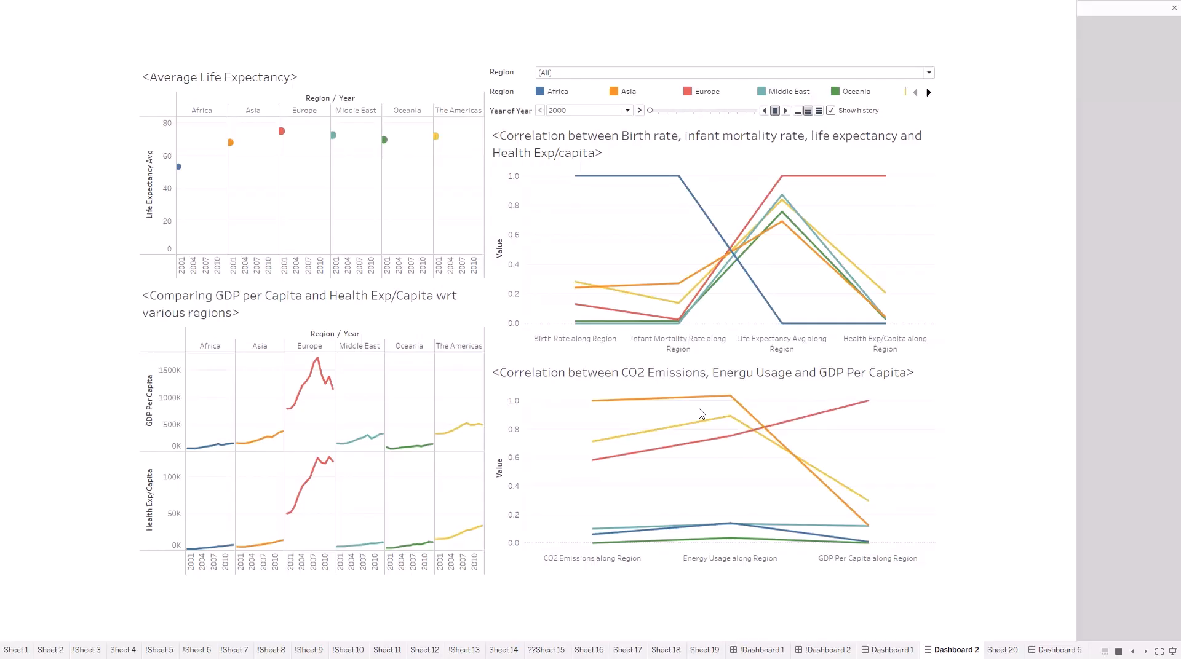

Slide 5
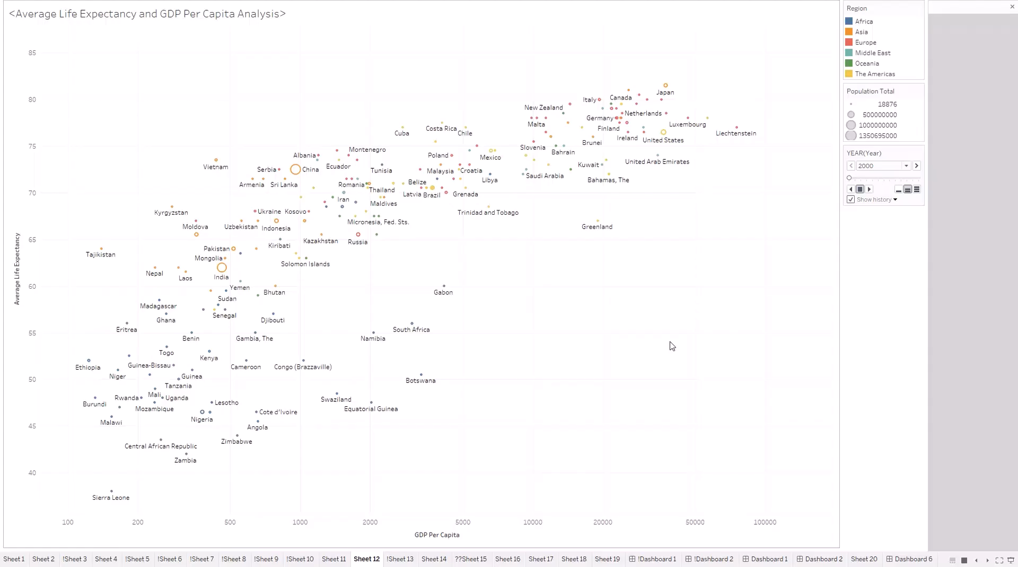

Slide 6
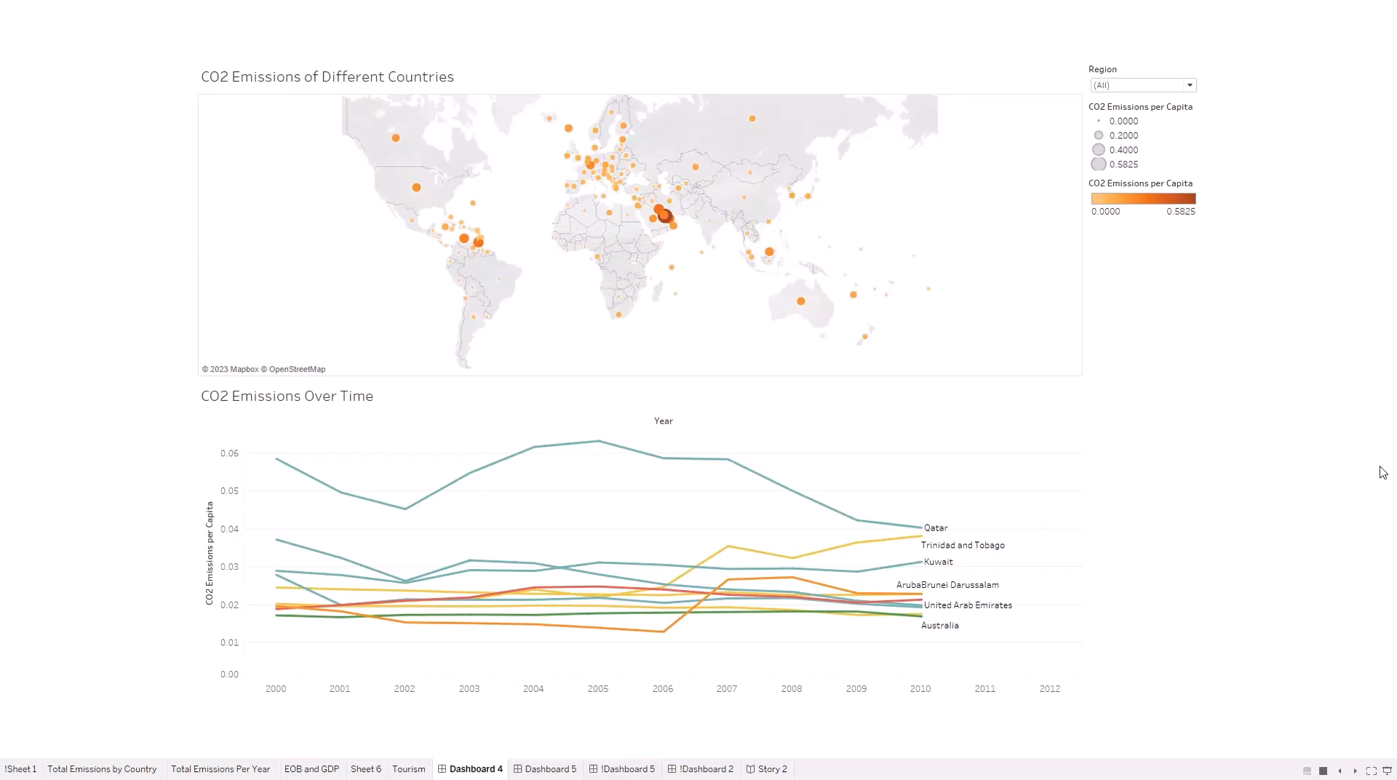

Slide 7
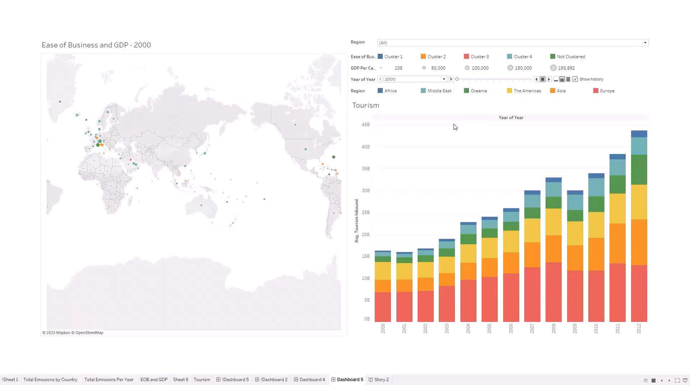

Slide 8
Conclusions
From Dashboard 1 , we noticed that Birth Rate and Population need not be correlated as commonly believed ! Asia has highest world’s population followed by Africa, population increases as time increases and countries consume mobile data more than internet data!
From Dashboard 2 , we noticed that Europe and Middle east had higher life expectancy, and the year 2007 was the peak point for Europe when it had health expenditure/capita and GDP/capita over 10 years. Also less developed regions like Africa, had higher birth rate and infant mortality rate, and lower life expectancy, Health/capita. Developed regions had higher GDP/Capita and lower energy consumption,CO2 emissions signalling green energy transition.
From Dashboard 3, we noticed that as time progresses, life expectancy and GDP/capita increased for countries, with most of developed countries having higher life expectancy and GDP/capita happen to have less population and belong to Europe, American, Middle East regions.
From Dashboard 4, we noticed that Middle Eastern countries have higher CO2 emissions/capita with Qatar at the top followed by Trinidad, Tobago and Kuwait.
From Dashboard 5, we can visualize the ease of business in countries, along with their GDP per capita. Interestingly, the ease of business is higher in many countries where the GDP per capita is low, like India, Bangladesh and Pakistan ! On the right, we can see that Europe generates the most tourism revenue, while Africa generates the least.
In summary, the interplay of economic growth, healthcare quality, sustainability, ease of doing business and tourism revenue collectively shapes the trajectory of global development. We noticed global disparities in health, economy, and environment. Lower-income countries may benefit from focusing on sustainable development, education, and green energy initiatives to improve overall well-being.

